Slide 1
Lucy Boston –
Patchwork of the crosses
May 2021

Slide 2
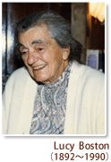
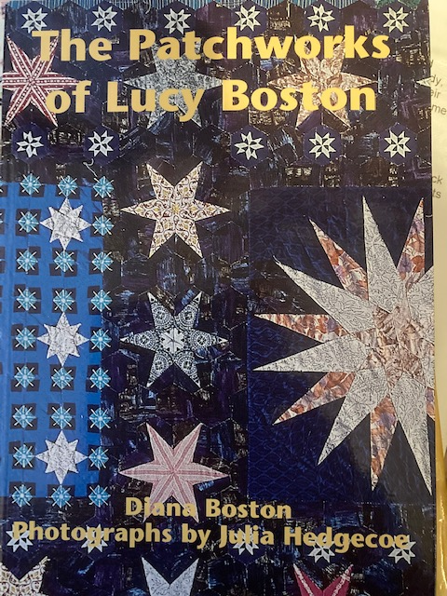
Lucy Boston (1892 -1990) of Hemingford Grey – author of ‘Green Knowe’

Slide 3
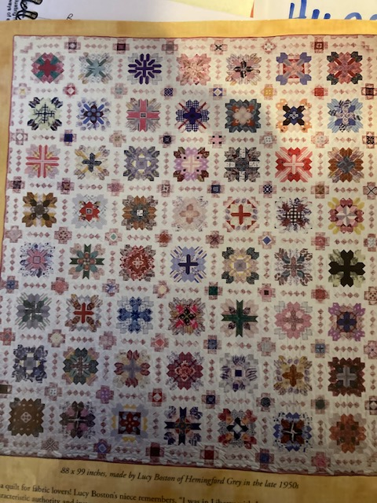

Slide 4
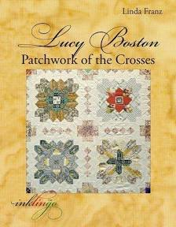
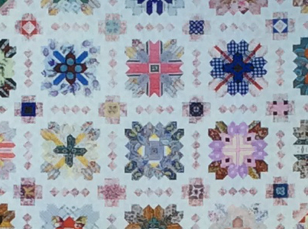
Patchwork of the Crosses (late 1950’s)

Slide 5
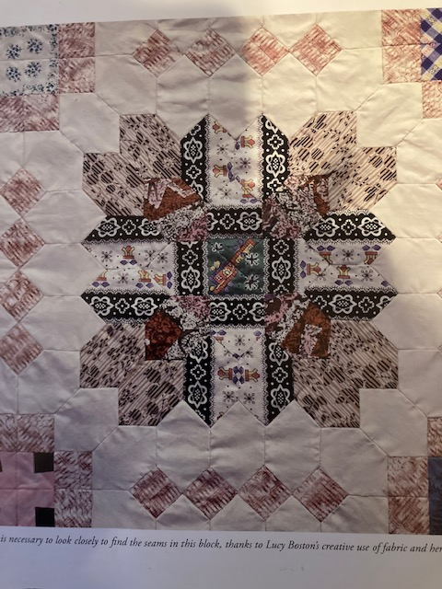
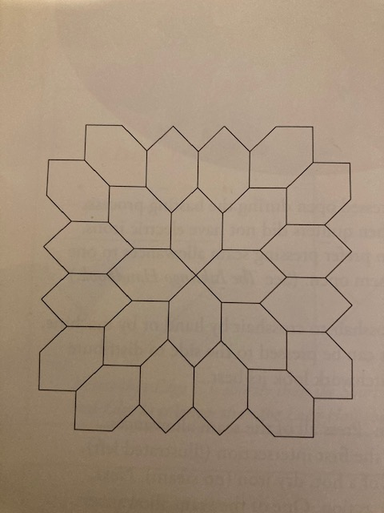
SIMPLE AND COMPLEX

Slide 6
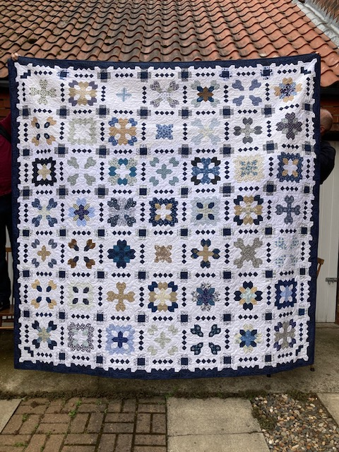

Slide 7
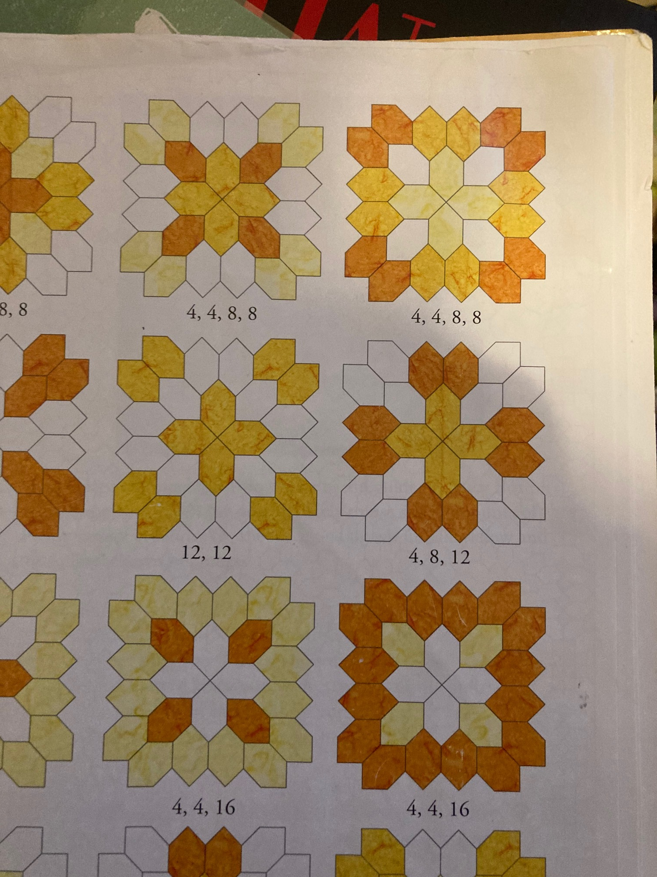
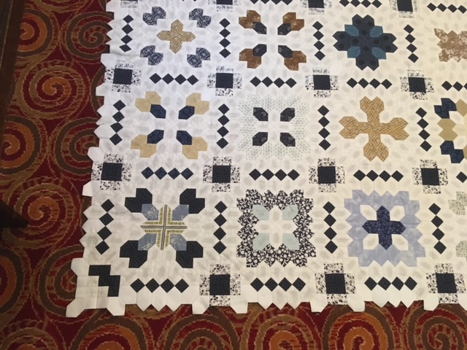
Basic Shapes: One inch honeycomb & ONE INCH SQUARE
Same shapes in many patterns
Value is the key

Slide 8
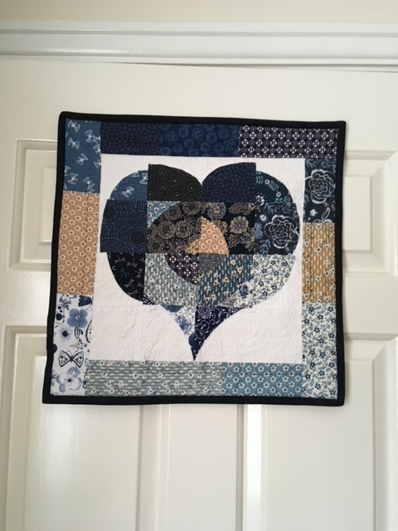
Focus Fabric

Slide 9
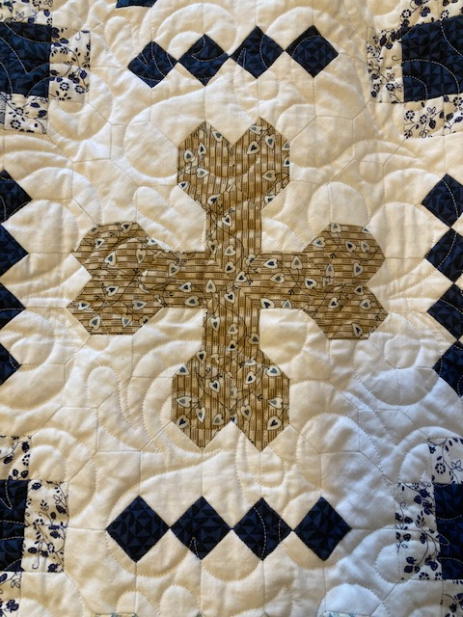
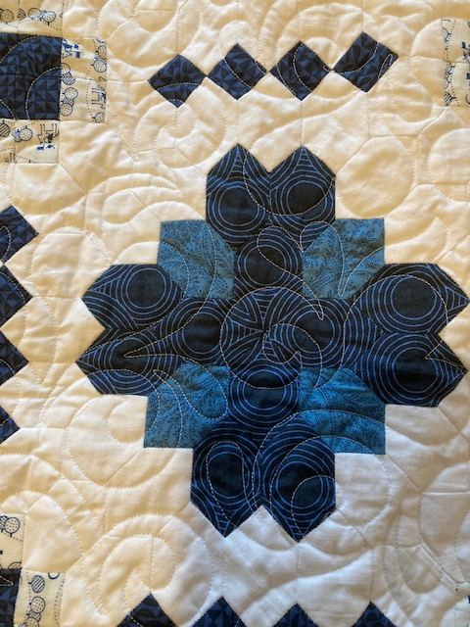

Slide 10
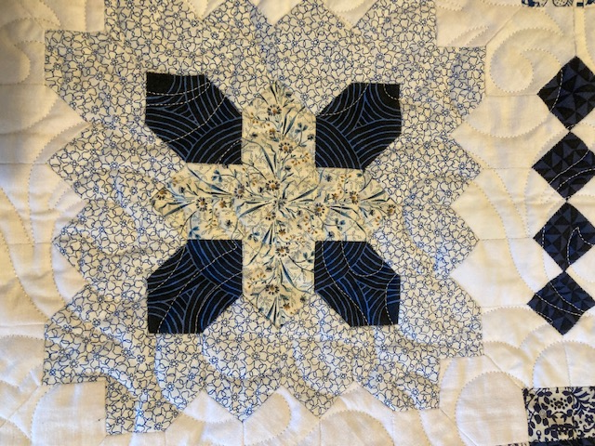
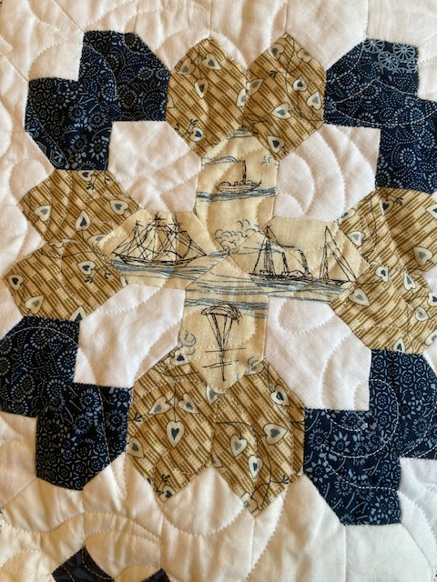

Slide 11
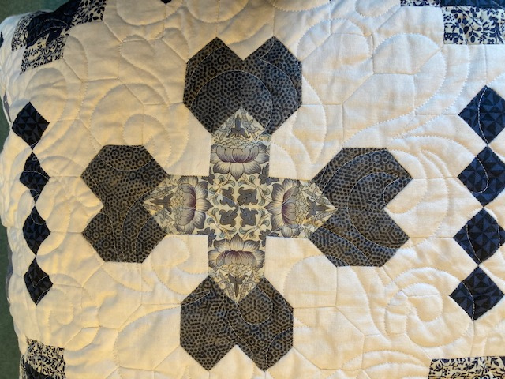
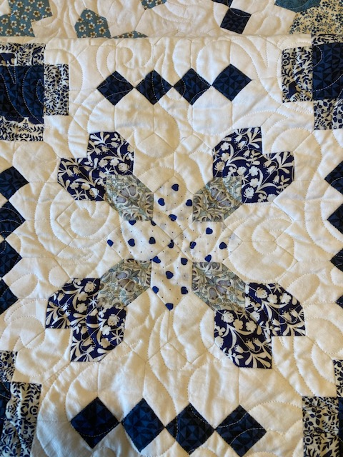

Slide 12
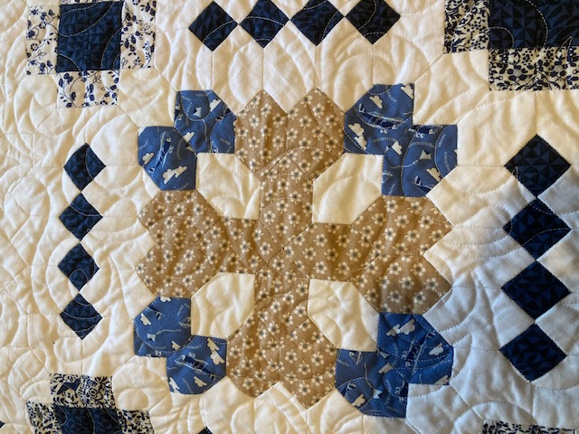

Slide 13
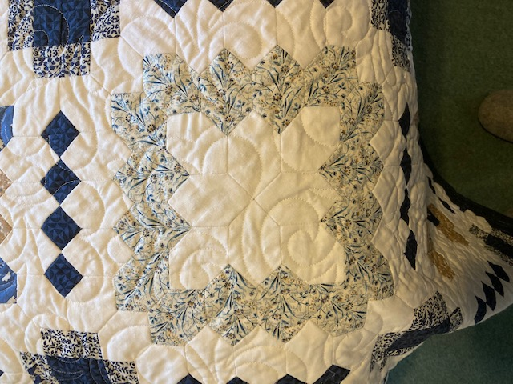
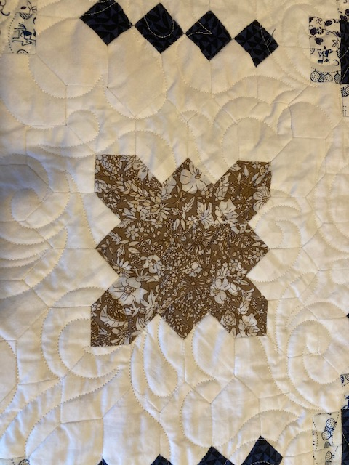

Slide 14
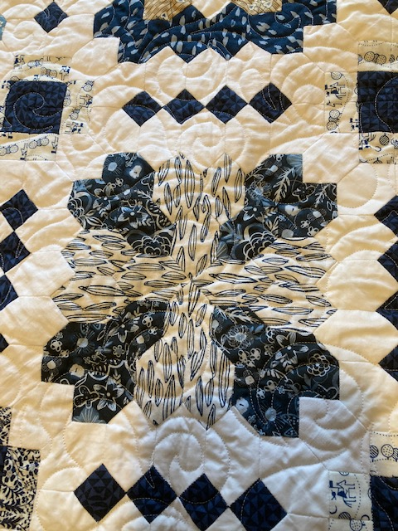

Slide 15
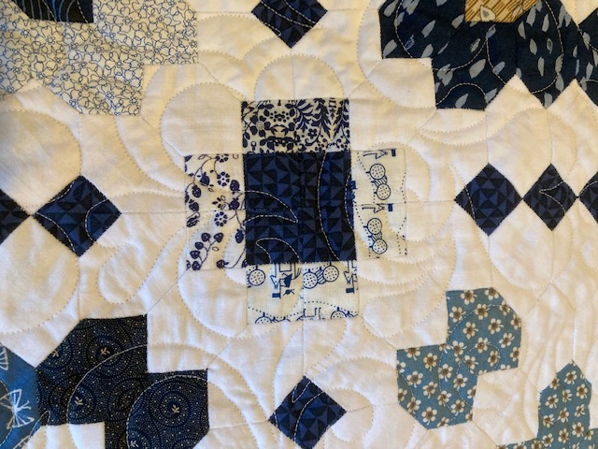

Slide 16
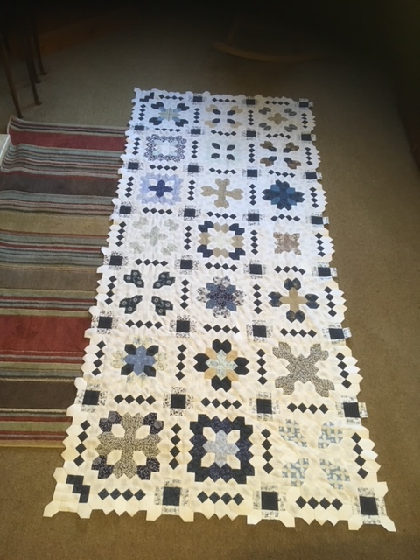
FollOW A Pattern and Watch it Grow

Slide 17
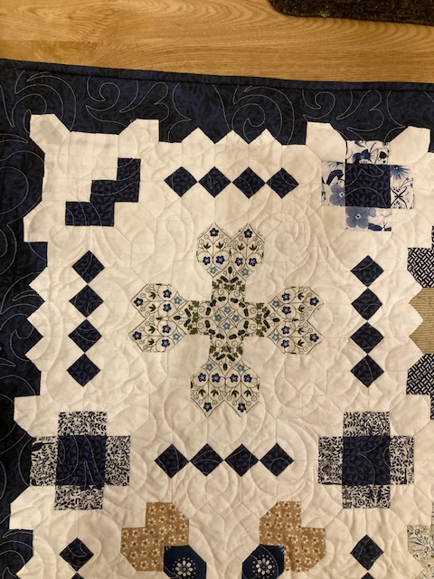
BoRDER AND fINISH

Slide 20
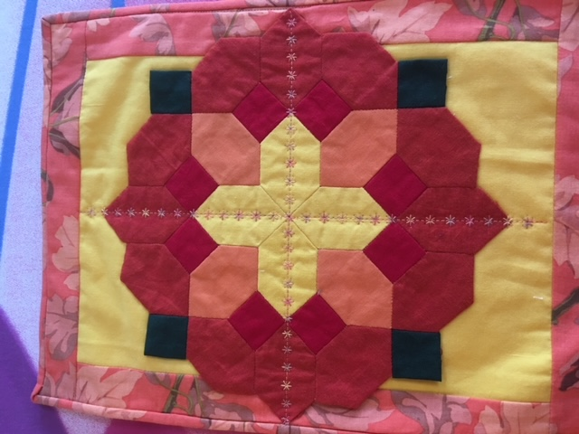
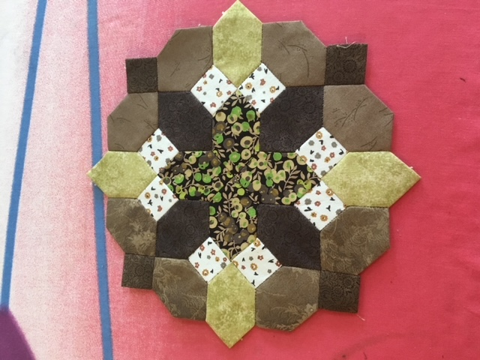
Other Colourways…

Slide 21
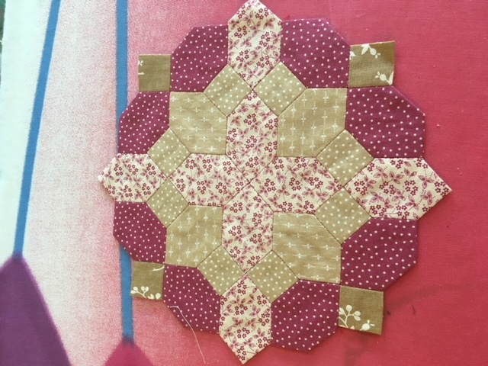
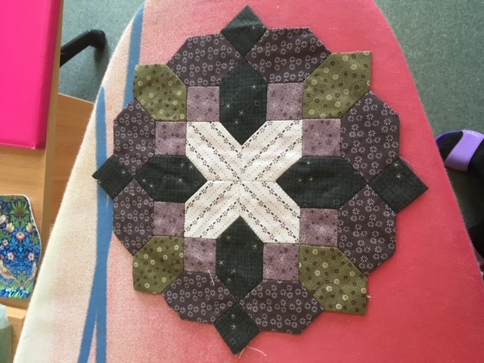
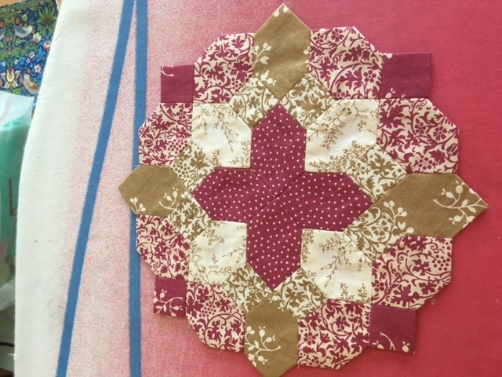
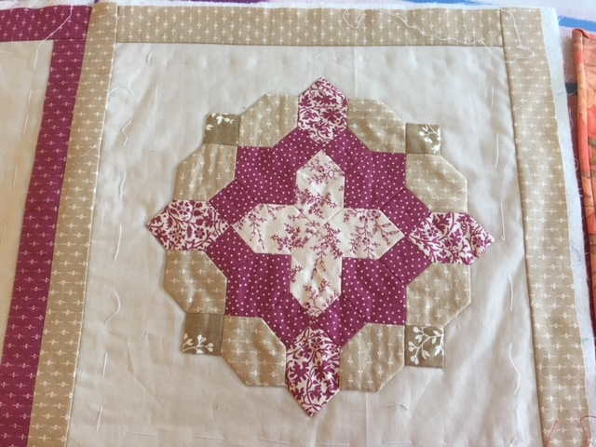

Slide 22
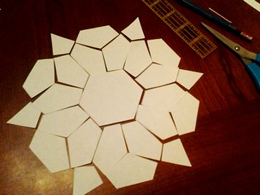
EPP TODAY
Accurate paper pieces can be bought
Amazing patterns and fabric
Wonder/binding clips
Freezer/ziplock type bags
Online community
Huge range of books
Therapeutic, social, portable

Slide 23
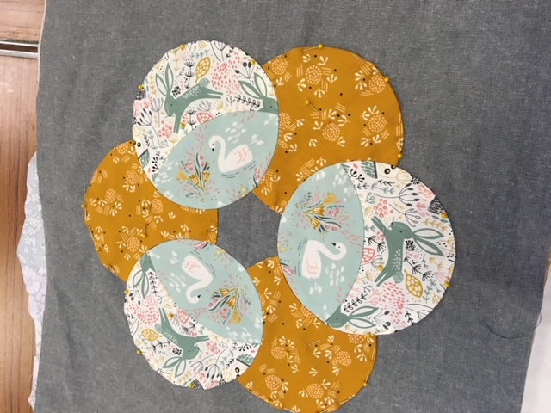
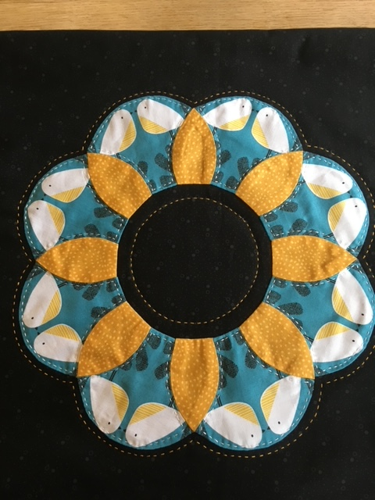
Fussy cut shapes do not need to be tiny

Slide 24
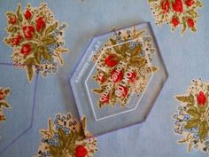
Fussy Cutting

Slide 25
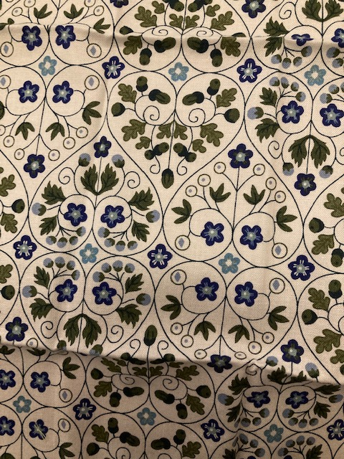
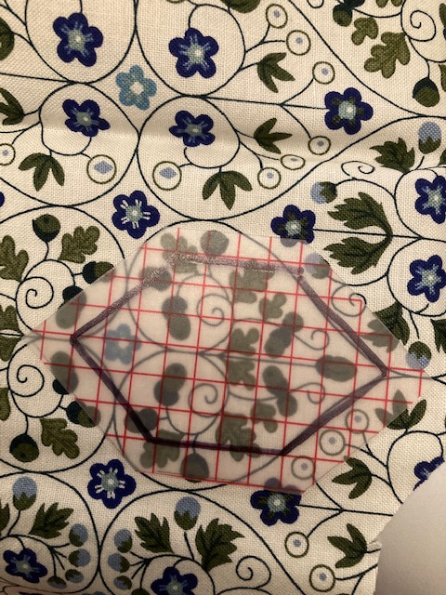
Find the image you like

Slide 26
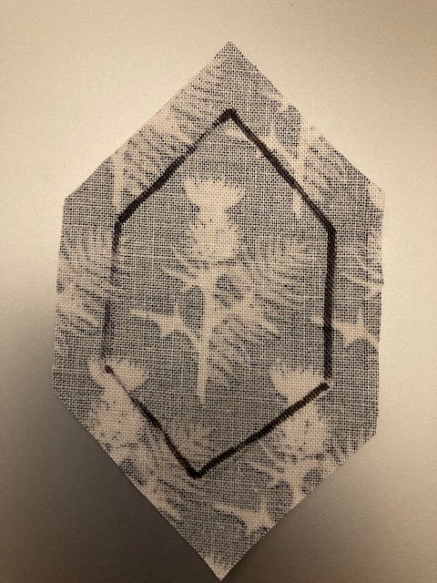
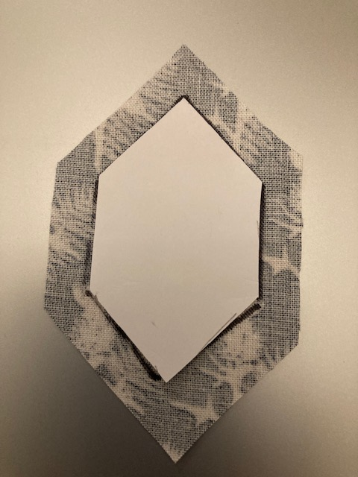
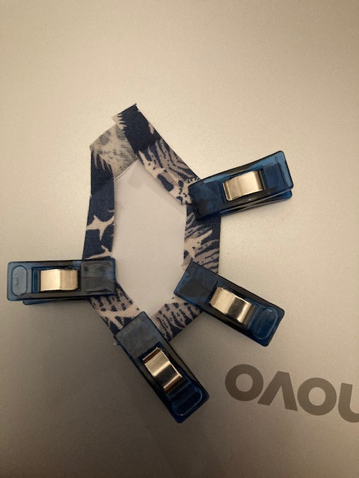

Slide 27
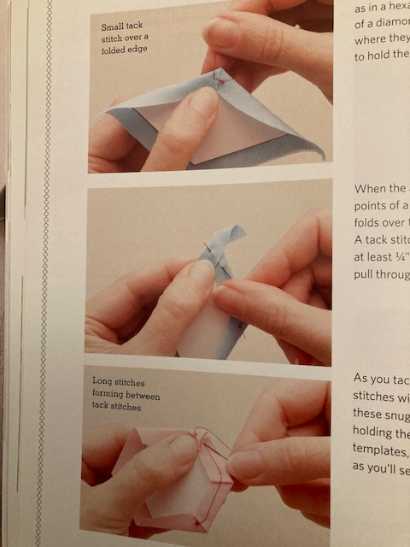
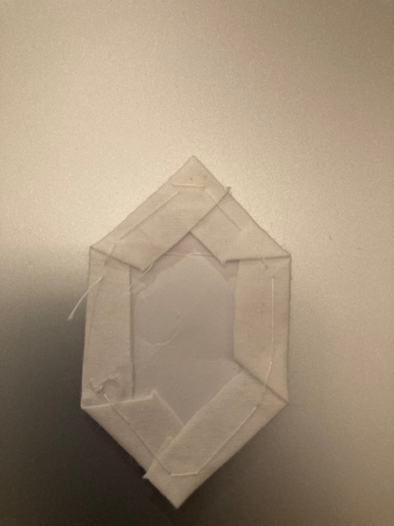

Slide 28
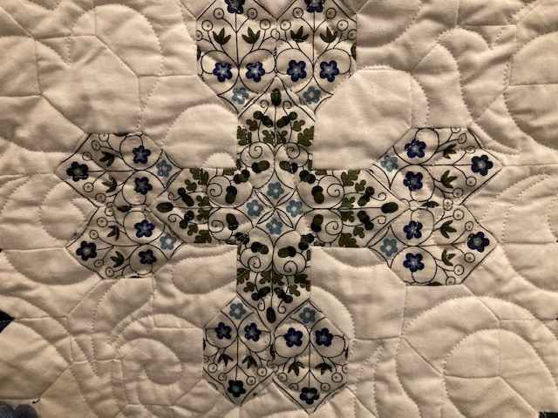

Slide 29
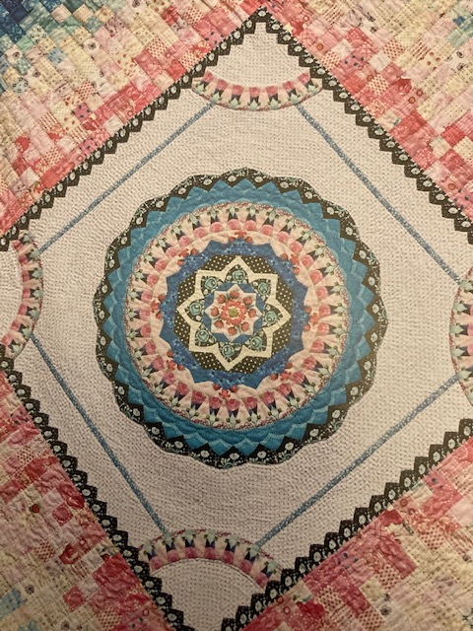
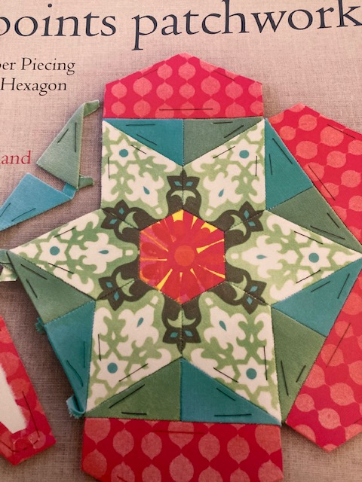
Amazing patterns can be created

Slide 30
ADD YOUR OWN
EMBELLISHMENT

Slide 31

Thank you so much for listening
Stay Safe
Sew on
Love Hilary X

Slide 32
Sources:
Diana Boston (2015) The Patchworks of Lucy Boston. Second edition. Oldknow books
Sharon Burgess (2017) Quilting on the go… English Paper Piecing. TUVA Publishing
Linda Franz (2009) Lucy Boston: Patchwork of the Crosses. Inklingo.
Diane Gilleland (2015) All points patchwork. English paper piecing beyond the Hexagon for Quilts and small projects. Storey publishing.
Florence Knapp (2018) Flossie teacakes guide to English Paper Piecing. Exploring the fussy-cut world of precision patchwork. The Quilting Company.
www.linapatchwork.com
www.sewmotion.com
www.sewandquilt.co.uk
www.greenknowe.co.uk
Pinterest and Facebook have interest groups and inspiration
HS 2021

